Slide 1

Search engine
BY
Challa Neeraja
Maddula Naga Shiva Kumari
Shaik afrin
Janga Sireesha

Slide 2
Outline
Objective
Introduction
Application Flow
Modules Used
Conclusion

Slide 3
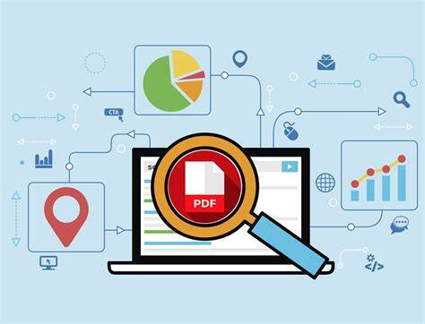
OBJECTIVE
Search Engine is a software that enables users to locate
information in database.
Search Engine is used for users that searches and identifies
from the database if not search in drive and locate in database.
When a task attempts to improve its performance on a search
Search Engine is known as SEO

Slide 4
introduction
THE PROJECT WAS DESIGNED :​
TO LOCATE DRIVES IN THE SYSTEM​
TO SEARCH THE FILE​
TO DISPLAY FILE LOCATIONS FOUND​​
TO SAVE AND RETRIEVE FREQUENTLY SEARCHED FILES FROM DATABASE​

Slide 5

Project flow
database
drives
Search in drives
loggers

Slide 6
Concepts used
OOPS
Threading
Loggers
Database
pytest

Slide 7
Win32api or windows api
This API is used for desktop applications that requires direct access to system features and hardware.
API(Application Program Interface) is set of functions and procedures that allows systems to integrate.
GetLogicalDriveStrings():
This function returns the list of drives in the system.

Slide 8
Threading
Thread: A Thread is a light weight process or smallest unit of a program or process executed independently .
Threads allows a program to operate more efficiently by doing multiple operations at the same time.
Types of Threads:
single Threading
Multi Threading

Slide 9
Single Threading vs multi thredaing
Single threading | Multi threading
Single threading process contains the execution of instructions by a single thread | This processes allow the execution of multiple parts of a program at the same time but share their resources.
More time for execution | Less time for execution
Complexity is less | Complexity is more

Slide 10
Loggers
Logging is used to tracking events that occur when the software runs.
Loggers automatically create Log Record files that have all the information related to the event being logged like name of the logger, message if error occurs it will store.
Levels in loggers
Debug
INFO
WARNING
ERROR
CRITICAL

Slide 11
DATabase
Database is a collection of organized information and it can perform CRUD operations.
For integration of python and database we need
Importing database
Creating object foe connecting to database
Connect=sqlite3.connect(databasename)
Creating object for cursor to execute sql queries
Cursor=connect.cursor()

Slide 12
pytest
Pytest is a testing framework that allows programmers to write test codes using python programming.
Pytest requires programmers need to define the function with ‘test_’ prepended and assert conditions.
In this project by using pytest 2 reports are generated
Html
Allure

Slide 13
conclusion
The primary goal of a search Engine is to provide high quality and speed results for users.
Search Engines are able to return the results quickly.
Search engines acts as filters for wealth of information available in the system.

Slide 14
THANK YOU

